Slide 1
Restaurant WEB PAGE
CSE326

Slide 2
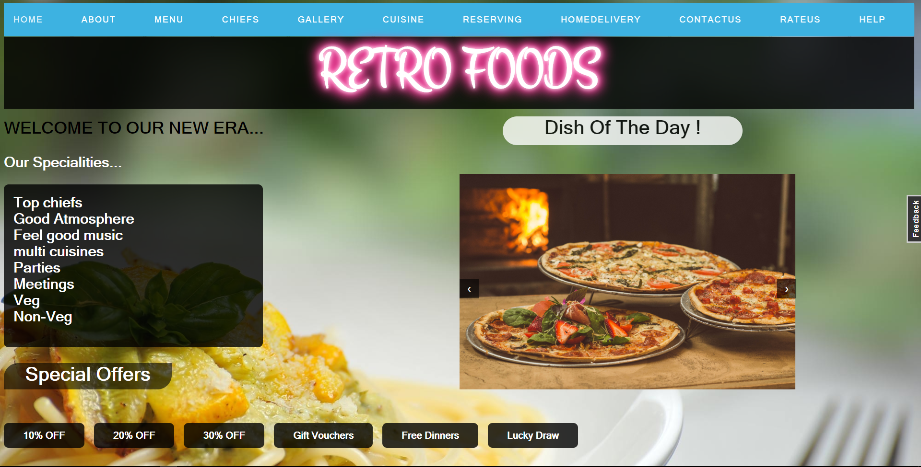

Slide 3
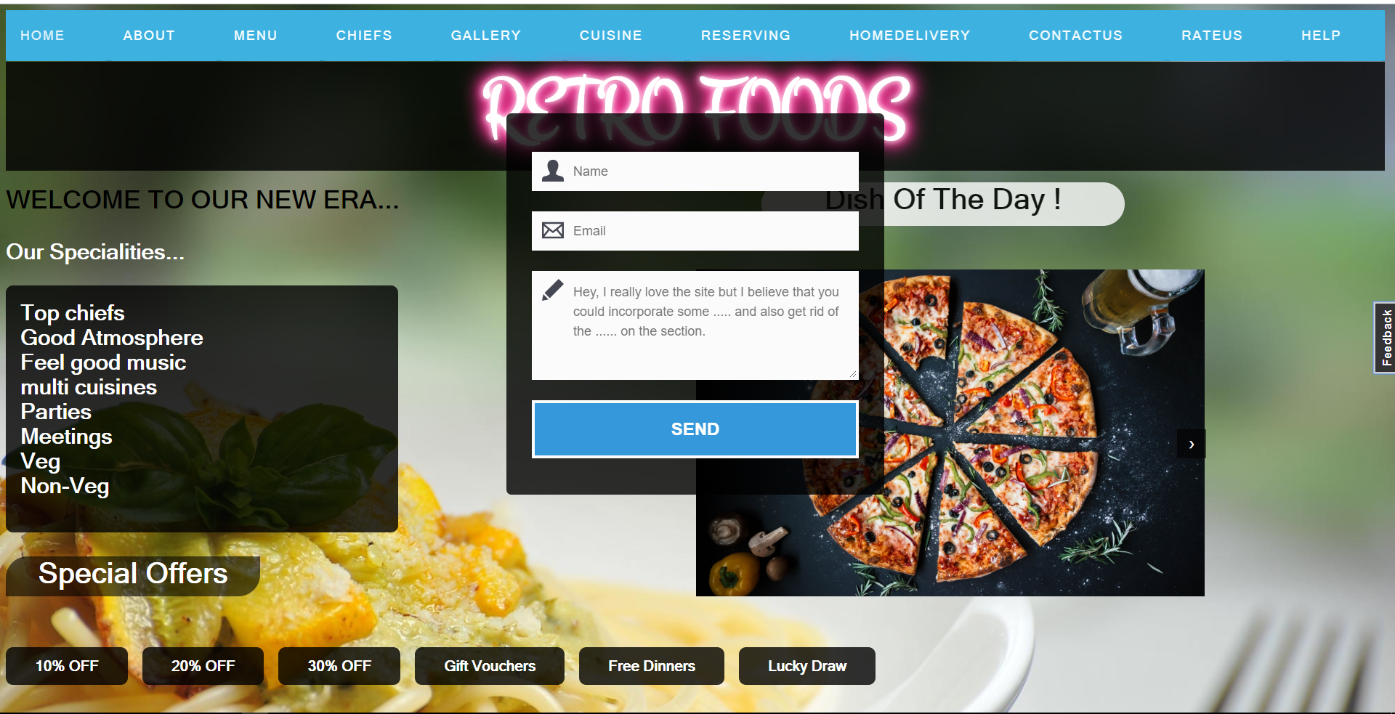

Slide 4
Homepage of Restaurant
Homepage is made of HTML,CSS,JS.
Nav bar is made of html,css.
Like <a> tags,background color,background image,background size
And some part is made of java script like using document.getElementById(),document.getElementByClassName.
Using of hover tages make the text attractive while placing the mouse on it.
By using the web transformations and keyframes we can make the nav bar,heading of retro foods attractive.
Here feedbackbutton is made using js ,html,css

Slide 5
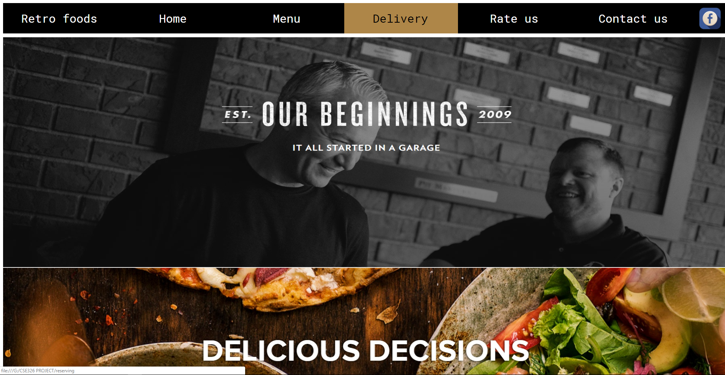

Slide 6
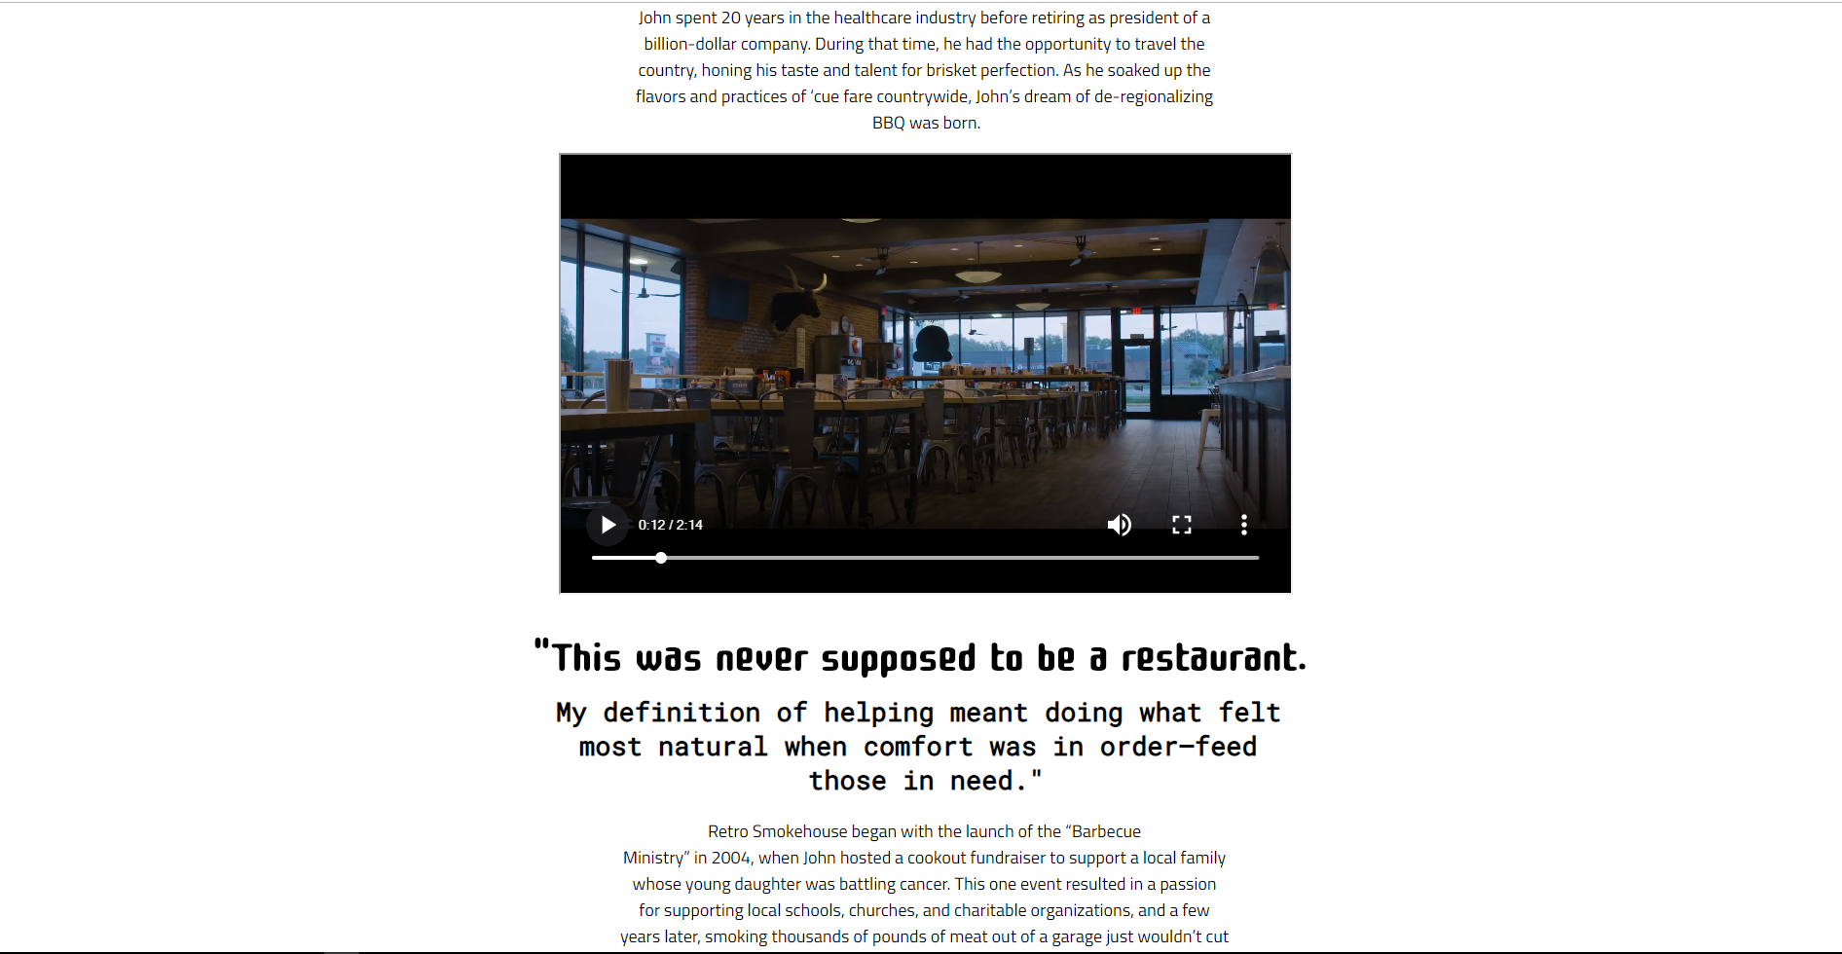

Slide 7
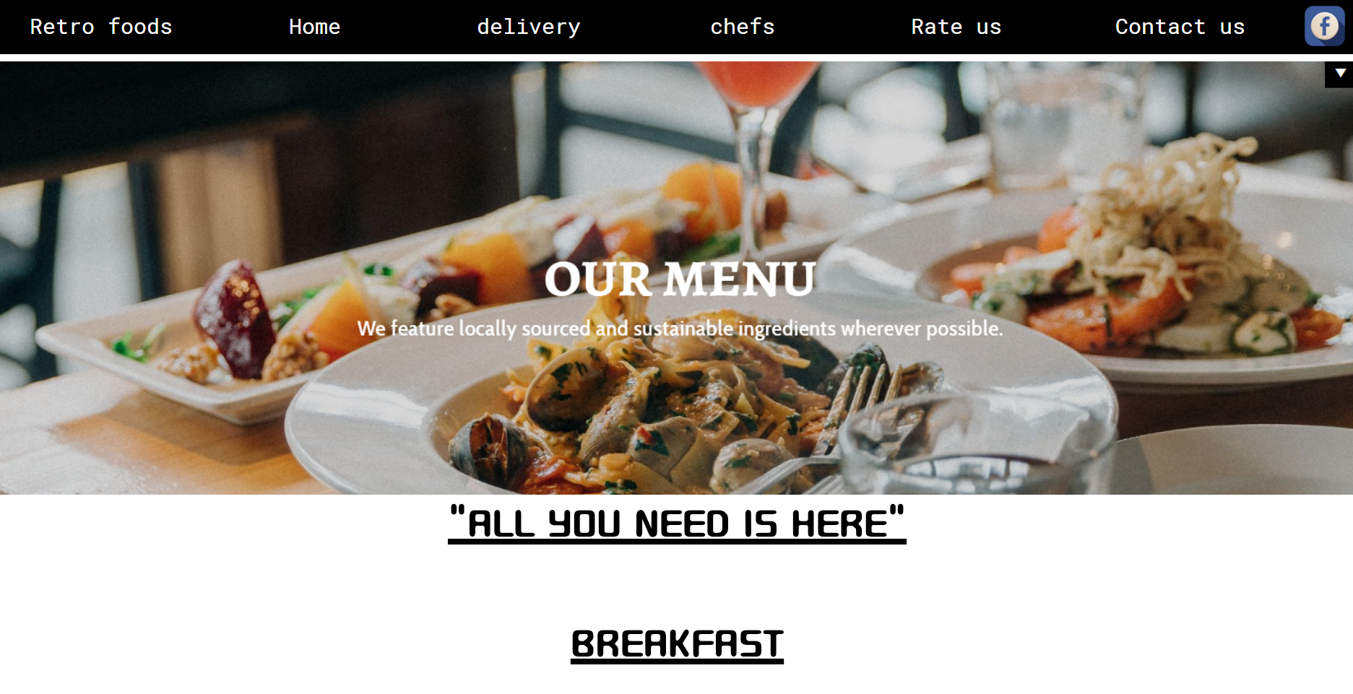

Slide 8
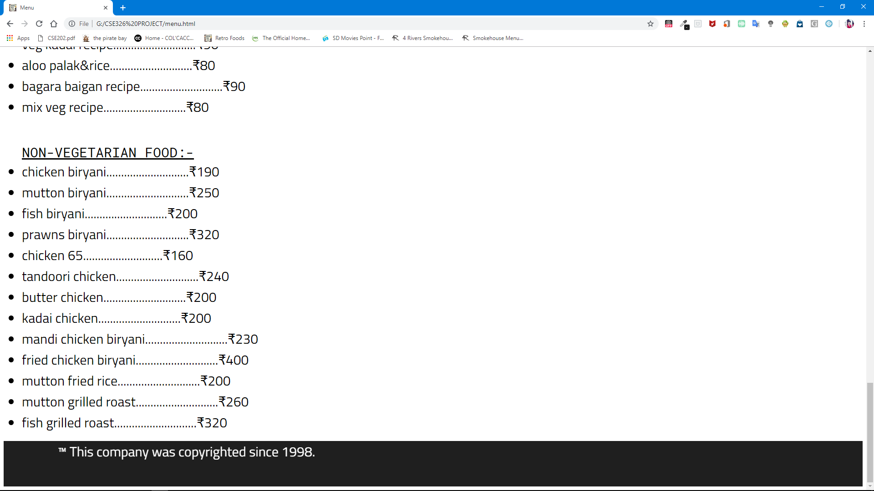

Slide 9
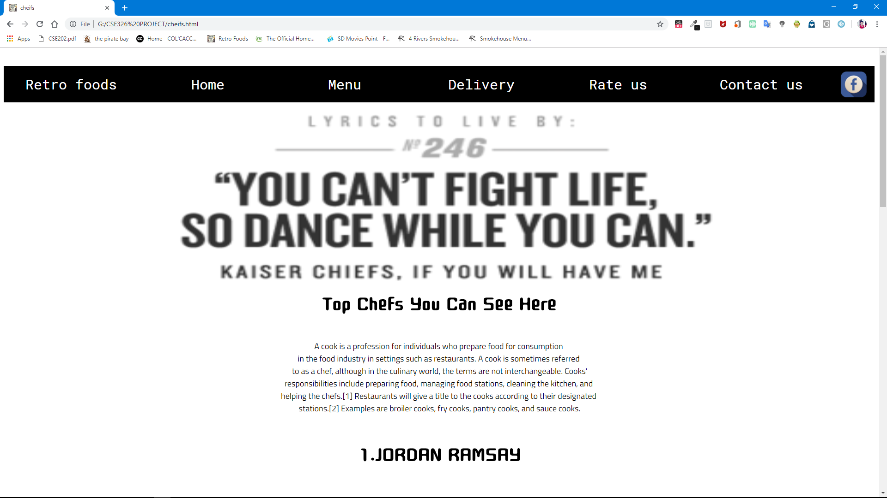

Slide 10
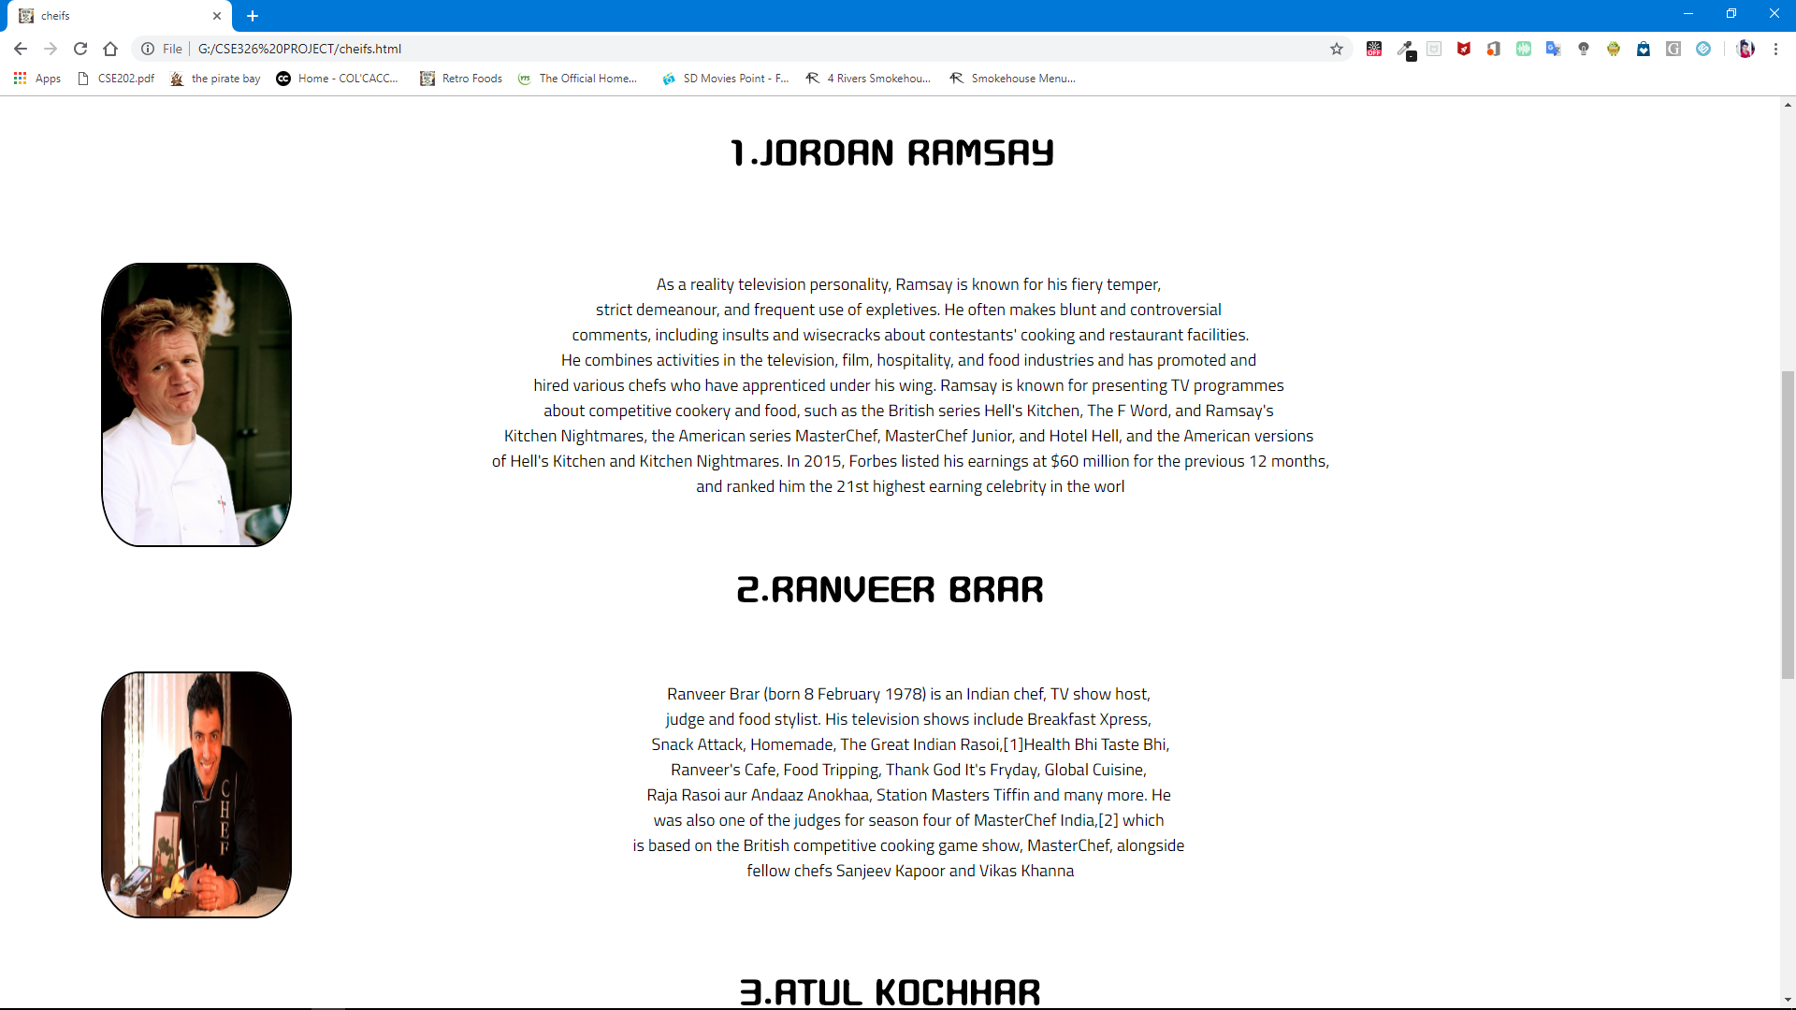

Slide 11
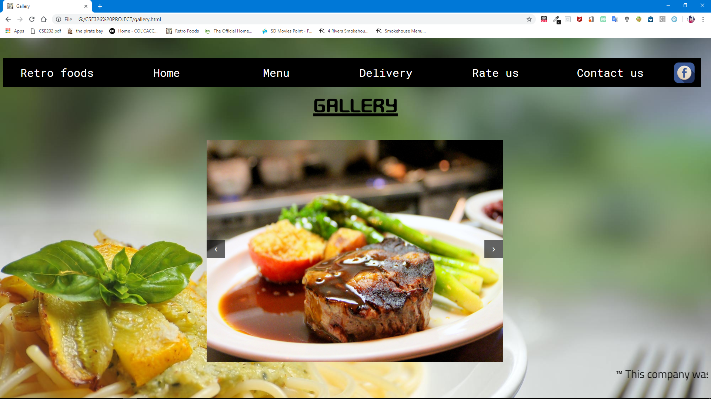

Slide 12
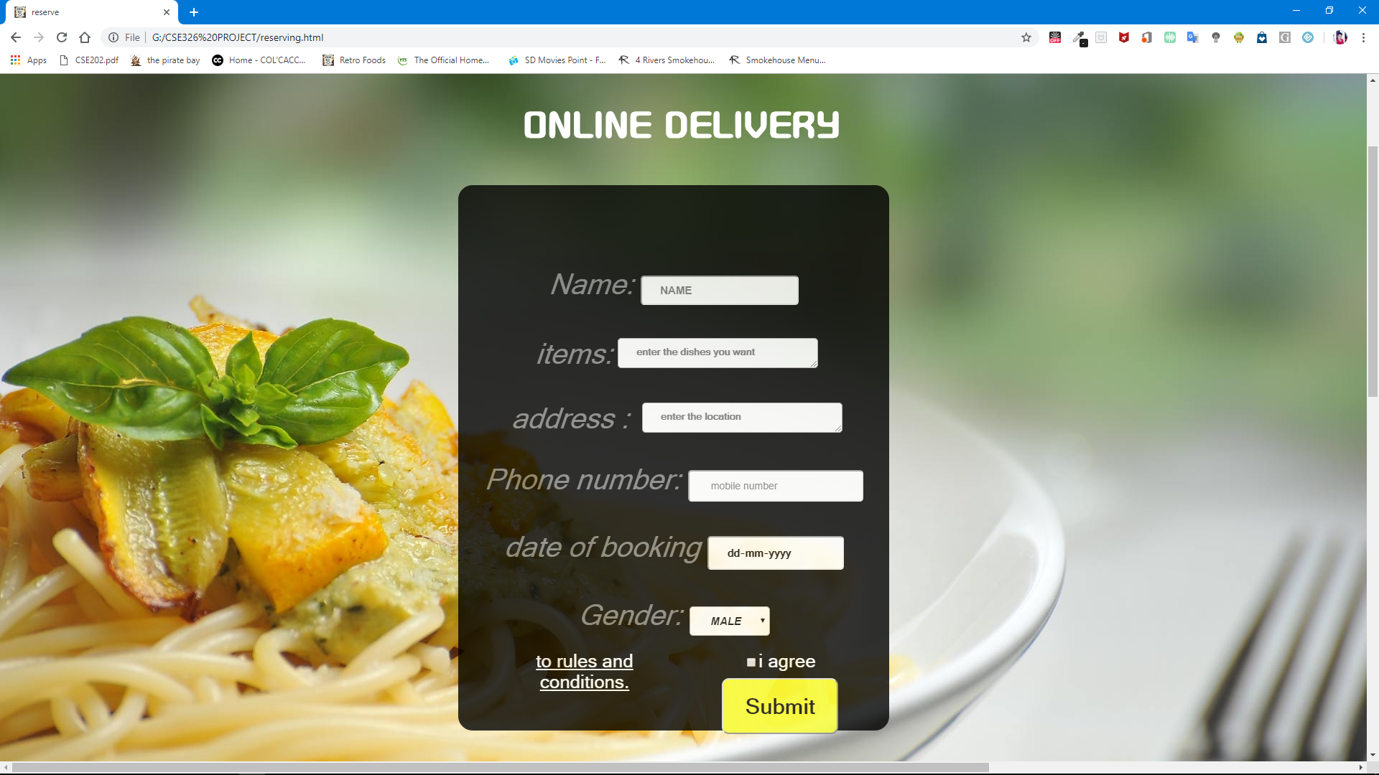

Slide 13
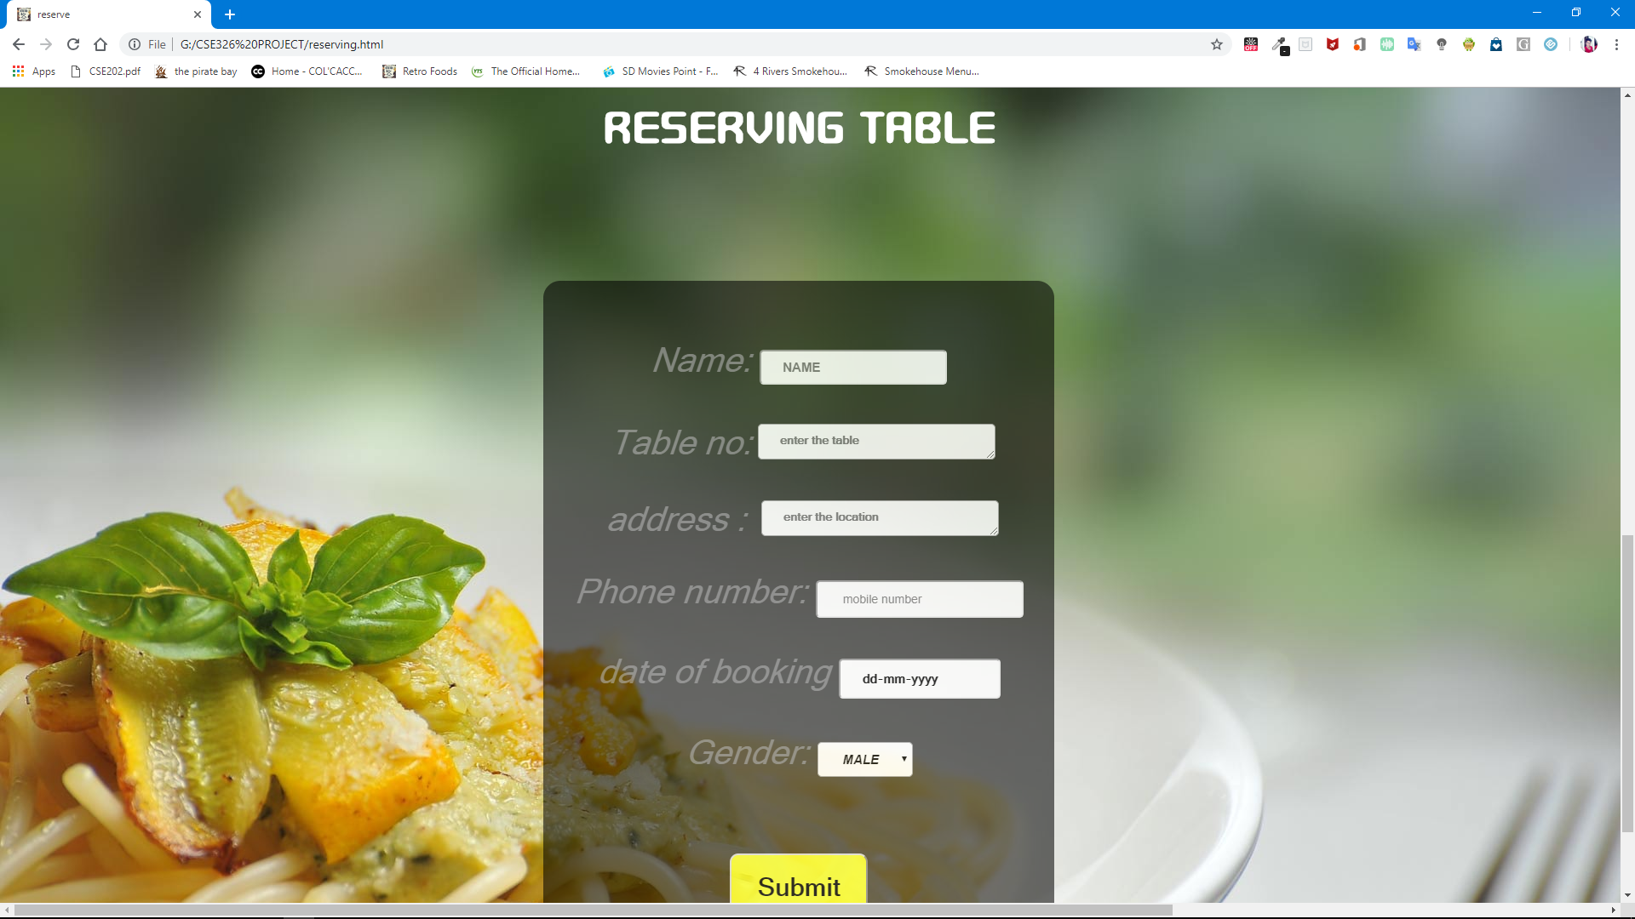

Slide 14
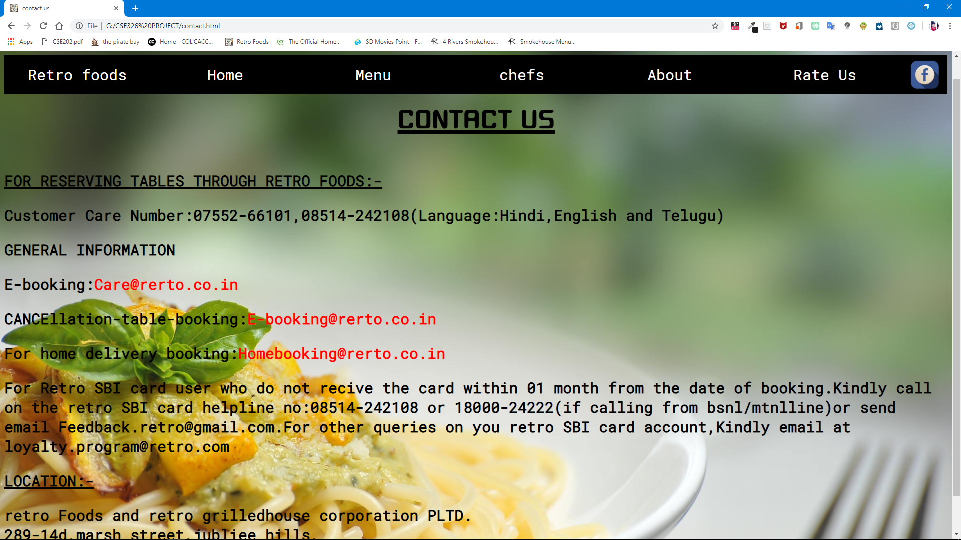

Slide 15
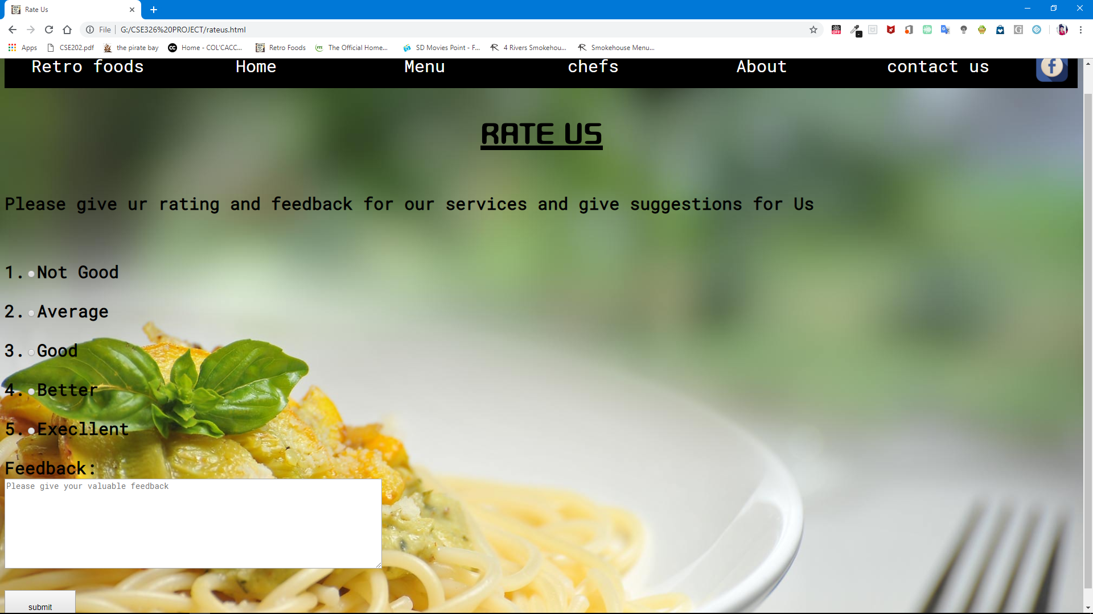

Slide 16
THANK YOU!!

